Slide 1
CACHE POISONING OVER DNS DNS SPOOFING
ȘTEFAN GROSU, DIANA VINTILĂ SAS 1

Slide 2
OVERVIEW
01
WHAT IS DNS CACHE POISONING?
02
TYPES OF ATTACKS
03
PROOF OF CONCEPT
04
CONCLUSIONS
Why is important? Problems…
Forging Attacks & Defragmentation Attacks
Show implementation & demo

Slide 3
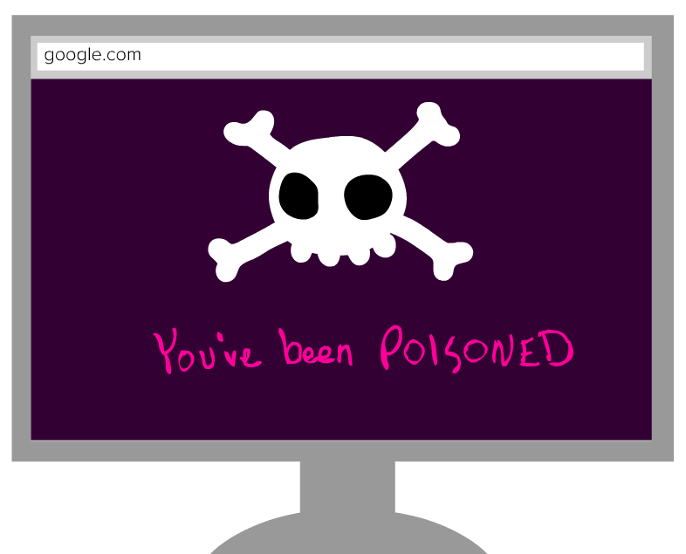
WHY IS IMPORTANT?
On 26 January 2015, a hacker group managed to redirect visitors of the Malaysia Airlines (MAS) official website to another site displaying malicious content.
The attackers abused the cached IP address in the DNS server to redirect their web site visitors to a completely different web page.
https://www.malaysiaairlines.com/my/en.html

Slide 4
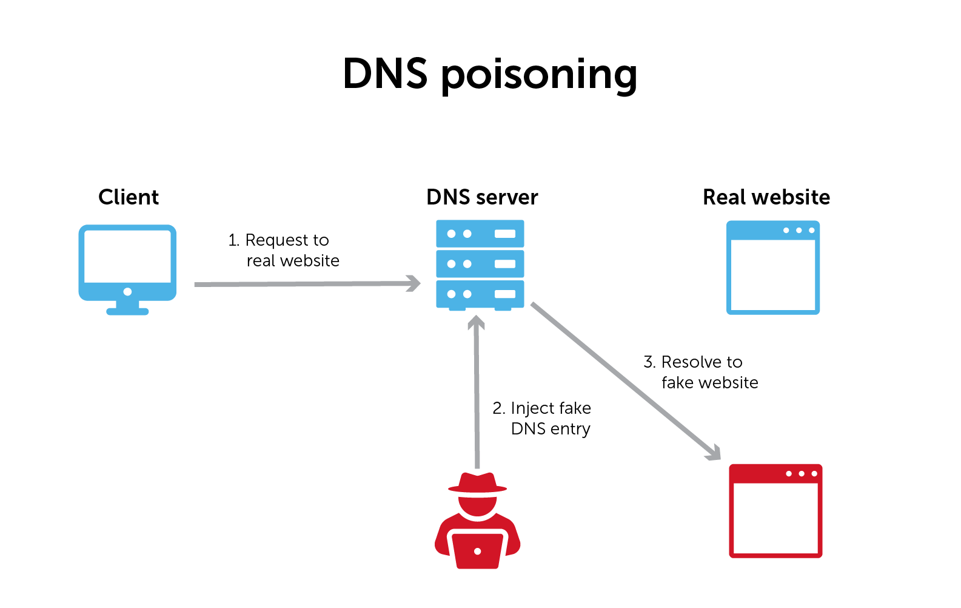
WHAT IS DNS CACHE POISONING?
Domain Name System (DNS) is a critical protocol of the internet that provides a way to resolve domain names to their corresponding IP addresses.
DNS cache poisoning is the act of entering false information into a DNS cache so that DNS queries return an incorrect response and users are directed to the wrong websites.
Poisoning cache with fake mapping: www.google.com A 6.6.6.6

Slide 5

Inherent DNS Vulnerabilities
Users/hosts typically trust the host-address mapping provided by DNS
DNS resolvers trust responses received after sending out queries
Responses can include DNS information unrelated to the query
Obvious problems:
No authentication for DNS responses

Slide 6
DNS Cache Poisoning Attacks: Type 1
Type 1: Forging Attacks
Guessing the metadata: TXID, src port
Example: the BIND Birthday Attack, the Kaminsky Attack
Birthday attack
* Force the resolver to send many identical queries, with different IDs, at the same time.
* Increase the probability of making a correct guess
The Kaminsky Attack
This is a sort of evolution of the basic cache poisoning attack, in which the victim is an entire domain instead of a single host
The aim of the attack is to feed a victim recursive DNS server with a forged response packet to spoof a NS record
Mitigation
randomize, randomize, randomize (RFC 5452)

Slide 7
Do randomization defenses end forging attacks?
E.g. SAD DNS Attack with side-channels

Slide 8
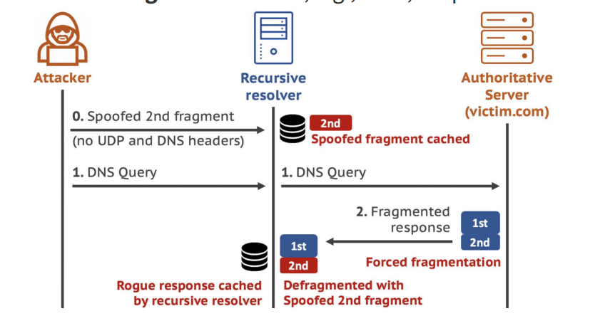
DNS Cache Poisoning Attacks: Type 2
Type 2: Defragmentation Attacks
Defragmentation attacks targeting DNS forwarders
The attack exploits the fact that the 2nd fragment of a fragmented DNS response packet does not contain DNS or UDP headers or question section, so it can bypass randomization-based defenses against forging attacks.
Mitigation
verify the oversized DNS response
0x20 encoding on DNS records
Xiaofeng Zheng et al. “Poison Over Troubled Forwarders: A Cache Poisoning Attack Targeting DNS Forwarding Devices.” USENIX Security Symposium (2020).

Slide 9
Proof of concept (PoC)
We used Ettercap to implement the attack.
The attacker will be a Kali VM and the client will be a Windows 10 OS.
Need to config: etter.conf & etter.dns:
on etter.conf file we must assure the gid and uid that Ettercap uses; redirect commands are enabled.
on etter.dns file we must add the record for the domain we want redirection
Set the injection records:
microsoft.com A 192.168.0.186
*.microsoft.com A 192.168.0.186
www.microsoft.com PTR 192.168.0.186
When the client will want to access microsoft.com, will be redirected to the Apache server from the VM.

Slide 10
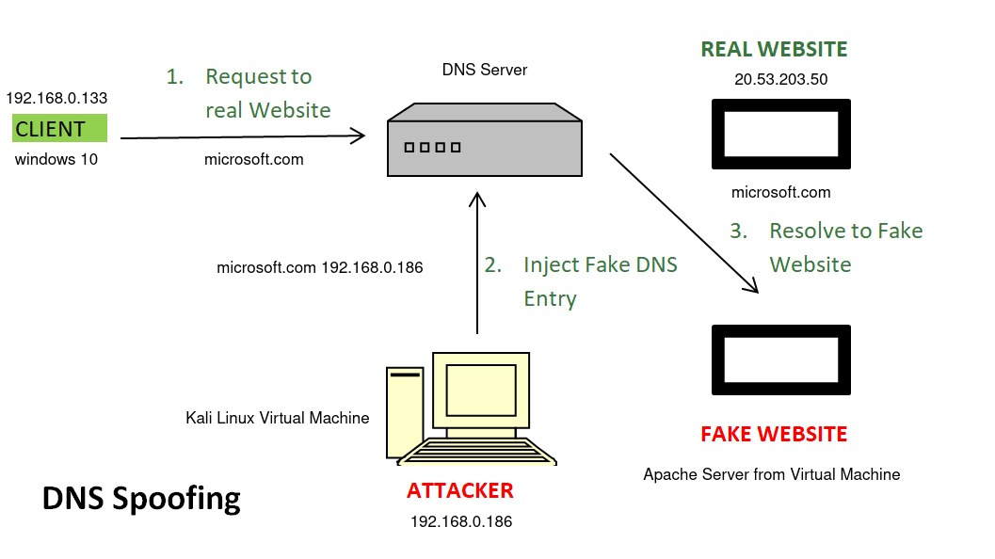
DNS Cache Poisoning Attacks: Type 1
Type 1: Forging Attacks
Guessing the metadata: TXID, src port
Example: the BIND Birthday Attack, the Kaminsky Attack
Birthday attack
* Force the resolver to send many identical queries, with different IDs, at the same time.
* Increase the probability of making a correct guess
The Kaminsky Attack
*
* Increase the probability of making a correct
Mitigation
■ randomize, randomize, randomize (RFC 5452)
Threat Model

Slide 11
CACHE POISONING ATTACK DEMO

Slide 12
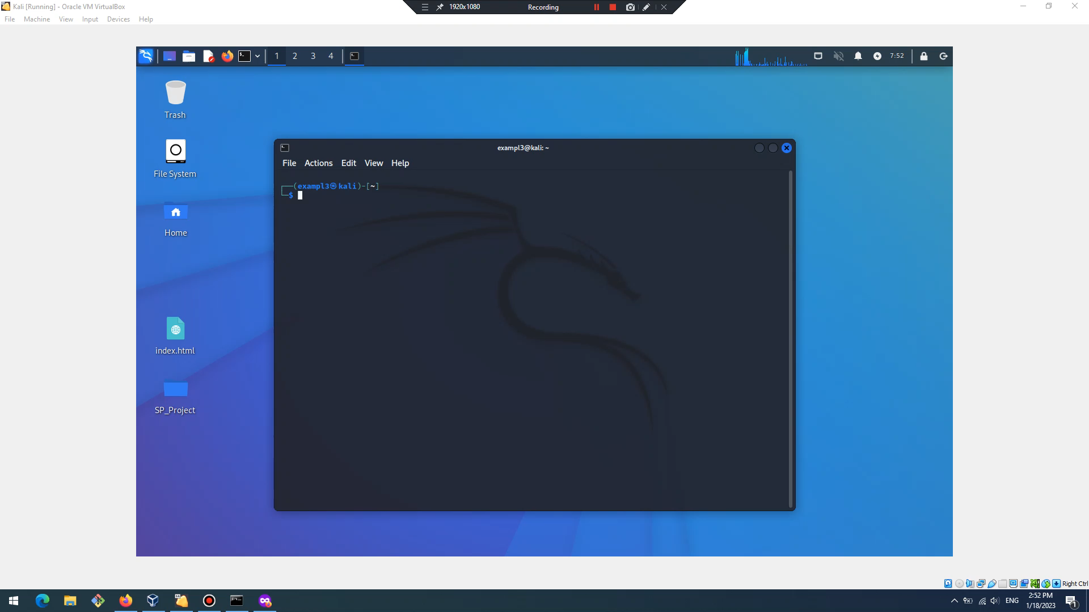

Slide 13
MITIGATION
enable DNSSEC for your domain: will create a unique cryptographic signature and store it alongside other DNS records
defense using The Bailiwicks Rules: a recursive DNS server will not accept responses from an authoritative DNS that fall outside the scope of authority (bailiwick) of the authoritative server.
use web browsers that enforce HTTPS connections by using HSTS (HTTP Strict Transport Security)
use a trusted VPN, where the DNS cache is configured on the VPN side and not on the local router

Slide 14
CONCLUSIONS
Poisoning and spoofing of the Domain Name System (DNS) are forms of cyberattack that exploit vulnerabilities of DNS servers to redirect traffic from legitimate servers to false ones.
The real reason why DNS cache poisoning is such an issue is that there is no real way to verify whether the DNS responses received are truly genuine or if they have been manipulated.
To prevent this from happening, it is important to employ the best security practices.

Slide 15
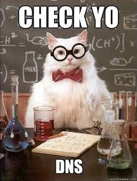
THANK YOU!
Do you have any questions?

